Slide 1

The Vehicle Plate Detection Using Multi-views
From a Single Fisheye Camera
Graduate Student:
Heru Syah Putra | M09158023
Advisor: Dr. Chuang-Jan Chang, Dr. Shu-Lin Hwang
Department of Electronics Engineering (EE)
Ming-chi University of Technology, Taiwan

Slide 2
Outline
Chapter II
Chapter IV
The theoretical basis and quotes from various sources related to research.
The results and discussion a detailed description of the research conducted.
Chapter I
Chapter III
Chapter V
Background that causes the problem of why this system is needed.
Methods used in the research description of the materials.
Contains a summary of the conclusions of the research results.

Slide 3
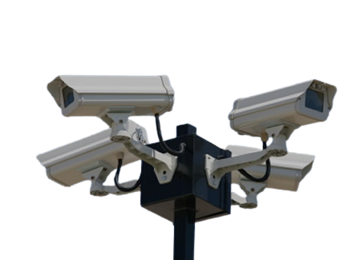
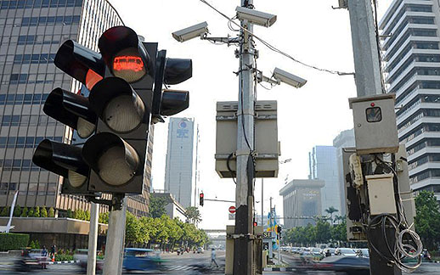
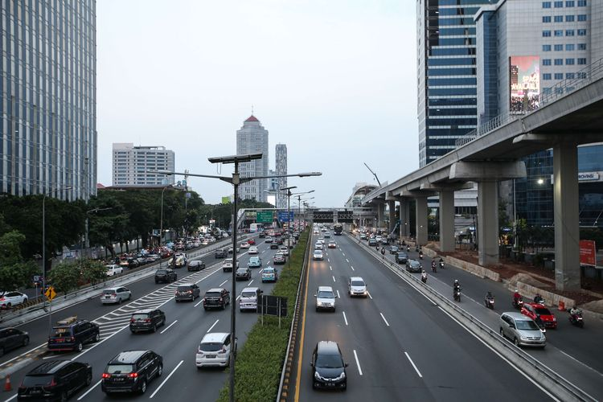
Chapter I. Research Motivation
Computer vision automates repetitive tasks that require human capabilities for continuous monitoring and timely decision-making on the road [2][3].
Figure 1. Cameras
Figure 2. Installed camera
Figure 3. View from a camera [3]
Various applications have been developed to meet the needs of these technologies, such as intelligent technology in detecting objects of interest [1][4][5].

Slide 4
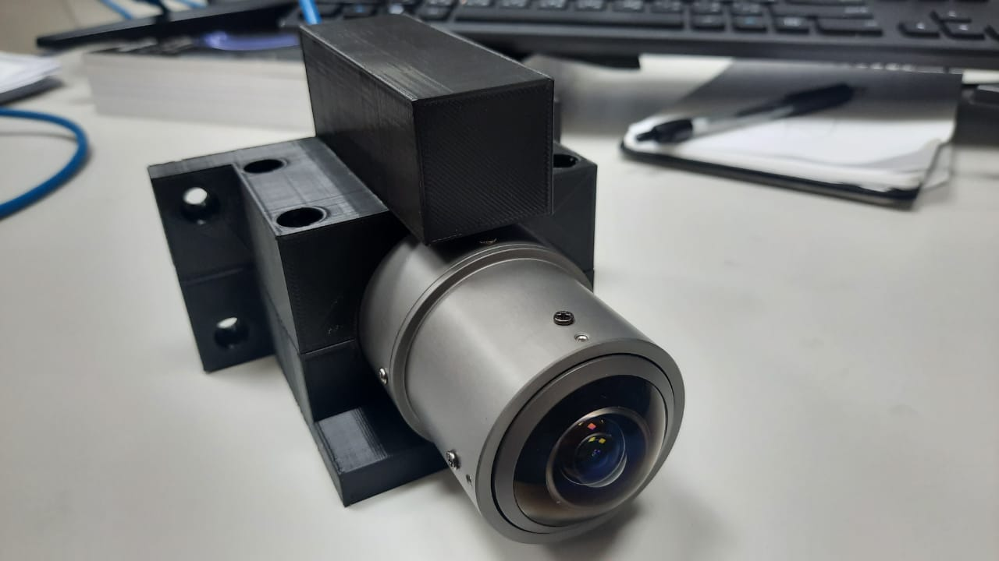
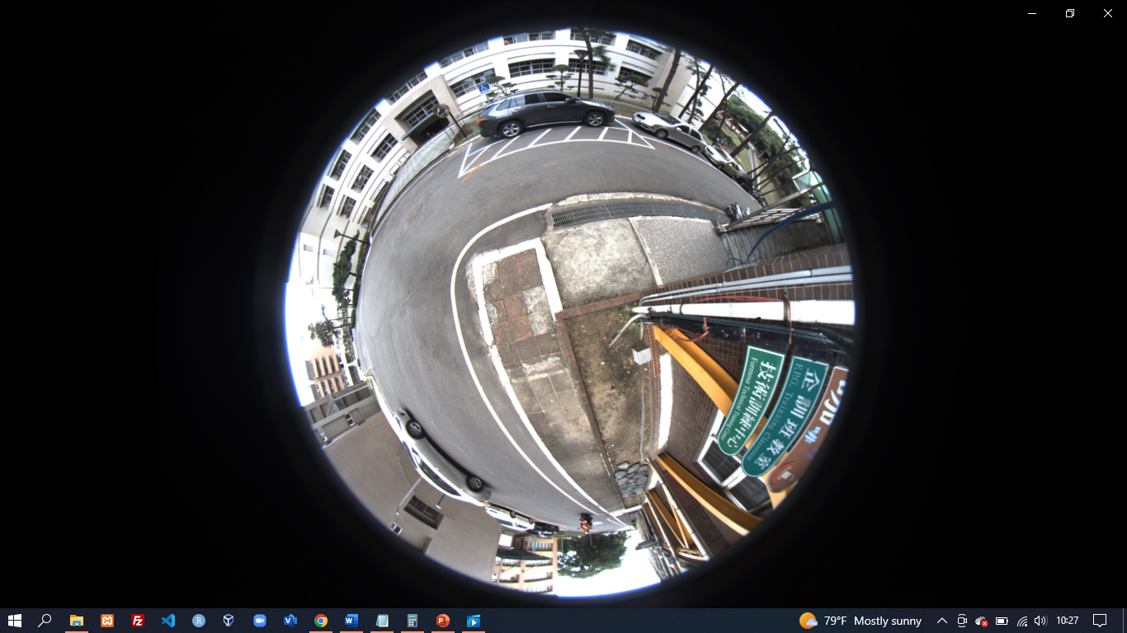
Chapter I. Research Motivation
Figure 4. Lens Fisheye Cameras
Figure 5. View from fisheye camera
A monitoring system for vehicle plate detection will be built using a fisheye camera, which will be used as a multi-view to get multiple angles from the desired target side with various views based on needs [7].

Slide 5
Chapter I. Thesis Objective
The thesis aims to study the implementation of the fisheye camera in the field of monitoring systems on vehicle plates by utilizing the coverage of the Field of View (FoV) from the Fisheye camera.
1
Use one fisheye camera to capture two different directions at equal Fields of View (FoV) coverage.
3
Implement the Yolov4 method to detect vehicle license plates.
2
To investigate the performance of the fisheye camera as the main sensor for getting more information.
4
Implementation of the Moildev library to create multi-views that can provide an alternative as a substitute for the many cameras on every corner of the area.

Slide 6




Chapter I. Contribution of Thesis
The research that will be carried out in making this thesis, there are several main contributions to be achieved, including:
01
02
03
04
The use of a Fisheye camera provides wider coverage of Field of View (FoV) and can be utilized to create multi-views.
Utilizing the wide angle generated from the Fisheye camera, which makes it the main source of vehicle information.
High accuracy improvement in recognition of vehicle license plate detection.
Makes it easy for operators to monitor entry and exit vehicles.

Slide 7
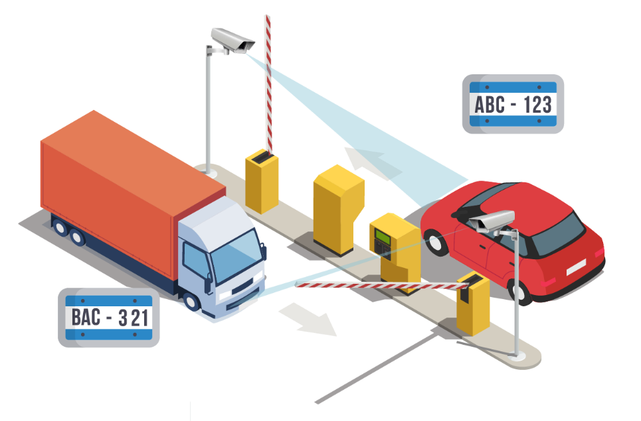
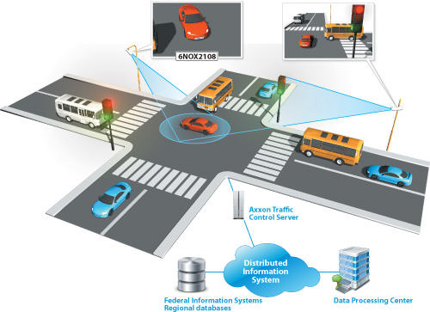
Chapter II. Literature Review
Simulation design developed by previous researchers for monitoring systems on the road.
Figure 6. The monitoring system [9]
Figure 7. The plate detection[10]

Slide 8
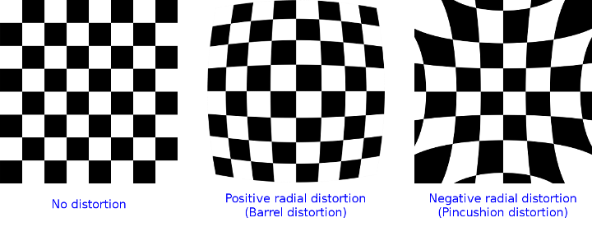
Chapter II. Literature Review
Camera Calibration: Especially for the calibration of MOIL cameras, this is a method that was fully developed in the MOIL laboratory.
Figure 8. Types of radial distortion [14]

Slide 9
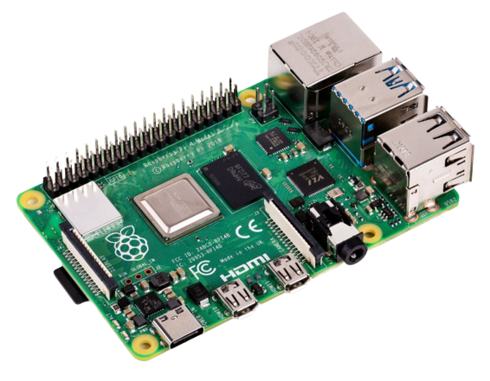
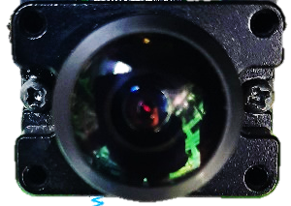
Chapter II. Literature Review
Table 1. Component Raspberry Pi
Raspberry Pi 4 Model B
Processor | Broadcom BCM2711, quad-core Cortex-A72 (ARM v8) 64-bit SoC @ 1.5GHz
GPU | Broadcom Video Core VI
Video & sound | 2 × micro HDMI ports (up to 4Kp60 supported) 2-lane MIPI DSI display port 2-lane MIPI CSI camera port 4-pole stereo audio and composite video port
RAM | 1GB, 2GB, or 4GB LPDDR4 SDRAM
Bluetooth | Bluetooth 5.0, Bluetooth Low Energy (BLE)
GPIO | Standard 40-pin GPIO header
Storage | microSD
Connectivity | 2.4 GHz and 5.0 GHz IEEE 802.11b/g/n/ac wireless LAN, Bluetooth 5.0, BLE Gigabit Ethernet 2 × USB 3.0 ports 2 × USB 2.0 ports.
Dimensions | Size: 88 mm × 58 mm × 19.5 mm, Weight: 46 g
Hardware: Building a monitoring system for vehicle plates requires additional interconnected hardware.
Figure 9. Lens Fisheye camera (Entaniya)
Figure 10. Raspberry Pi (Table 1)

Slide 10
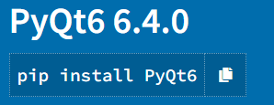
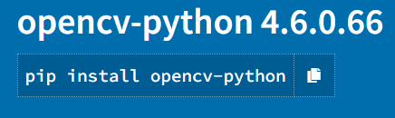
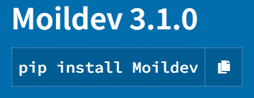
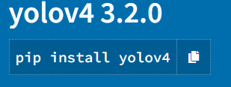
Chapter II. Literature Review
The software and libraries used in this project. The programming language uses "Python, and the PyQt library, OpenCV, and Moildev library" which have functions for Image Processing.
Figure 11. The library used

Slide 11
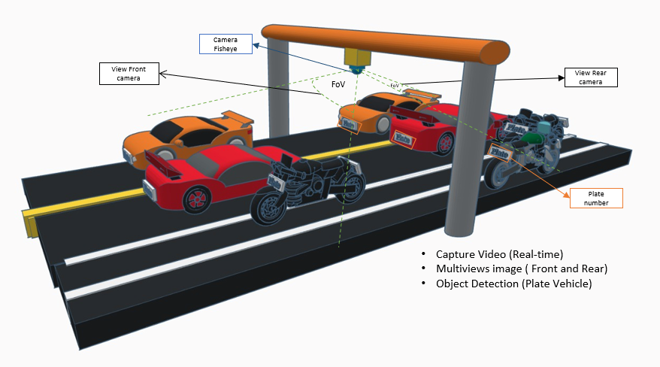
Chapter III. Analysis and Methodology
System analysis, an attempt to conduct an analysis understanding of a problem, is carried out by the study, which aims to gain a certain understanding of the problem being studied.
Figure 12. Simulation of design the case camera two views

Slide 12
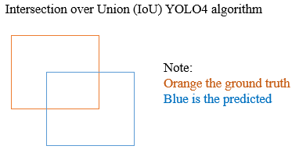
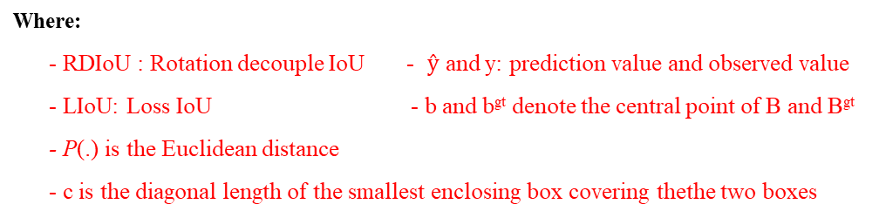
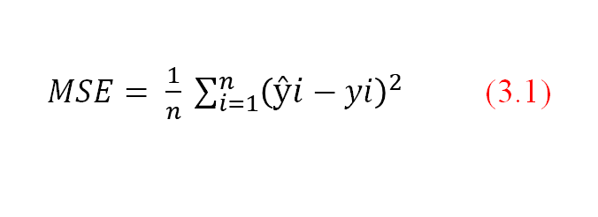
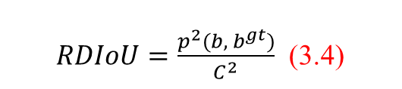
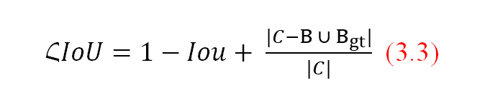

Chapter III. Analysis and Methodology
YOLOv4 Algorithm
Regressing the coordinates using the Mean Squared Error is the conventional method.
$MSE= \frac{1}{n} \sum_{i=1}^{n}{{\left(ŷi−yi\right)}^{2}}$ (3.1)
$IoU= \frac{\left(B_{ }∩ B_{gt}\right)}{\left(B_{ }∪ B_{gt}\right)}$3.2
$ՀIoU=1−Iou+ \frac{|C−B_{ }∪ B_{gt}|}{|C|}$ (3.3)
First, Distance-IoU Loss (DioU) is introduced as:
$RDIoU=\frac{p^{2}{(b, b}^{gt})}{C^{2}}$ (3.4)
Where:
- RDIoU : Rotation decouple IoU - $ŷ$ and y: prediction value and observed value
- LIoU: Loss IoU - b and b^{gt} denote the central point of B and B^{gt}
- P(.) is the Euclidean distance
- c is the diagonal length of the smallest enclosing box covering thethe two boxes

Slide 13
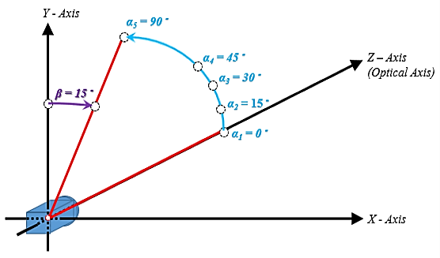
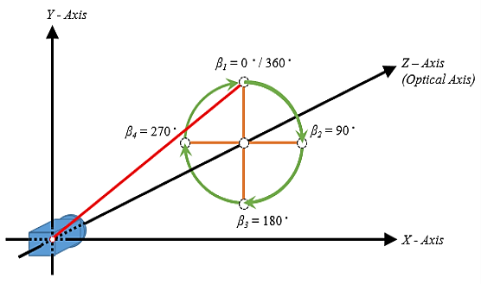
Chapter III. Analysis and Methodology
Figure 13. The Zenithal angle
Figure 14. The azimuthal angle
The zenithal angle is the angle from the vertical optical axis to the X-axis and Y-axis.
The azimuthal angle is defined as the angle of positive Y as the reference point with value 0 degrees, and the Z-axis is used as the rotation axis

Slide 14
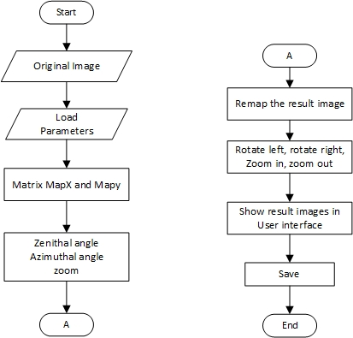
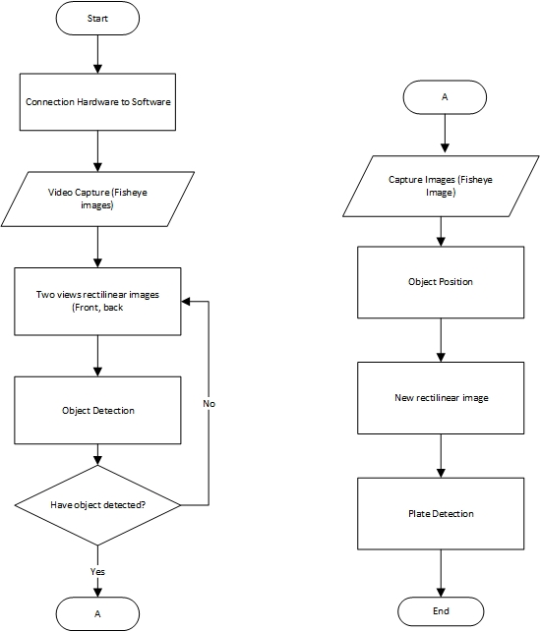
Chapter III. Analysis and Methodology
Method create a rectilinear View
System Workflow application

Slide 15
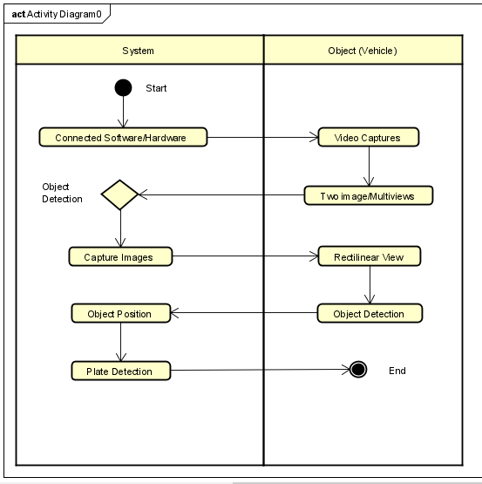
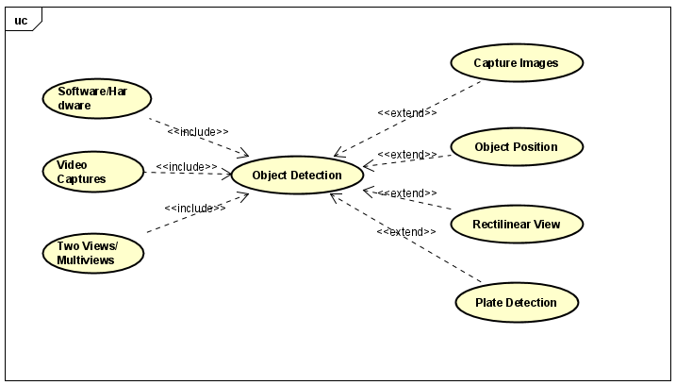
Chapter III. Analysis and Methodology
This system design stage is carried out after completing the problem identification and system analysis stage. The design includes Unified Modelling Language (UML) diagram, and interface design:
Figure 16. Use Case Diagram
Figure 15. Activity diagram

Slide 16
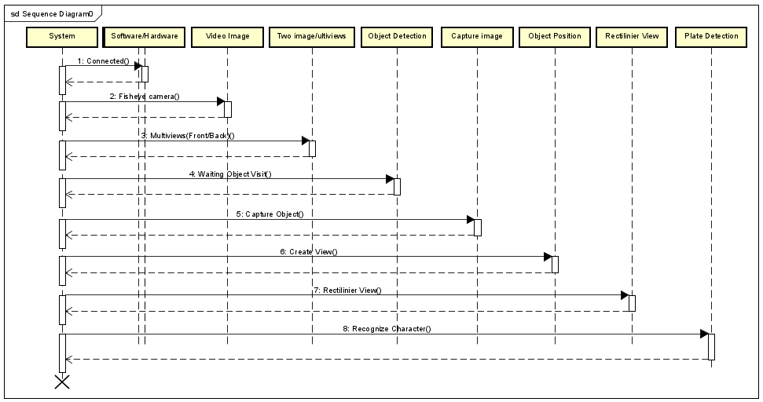
Chapter III. Analysis and Methodology
Sequence diagrams are commonly used to describe a scenario or series of steps performed in response to an event to produce a specific output.
Figure 17. Sequence diagram

Slide 17
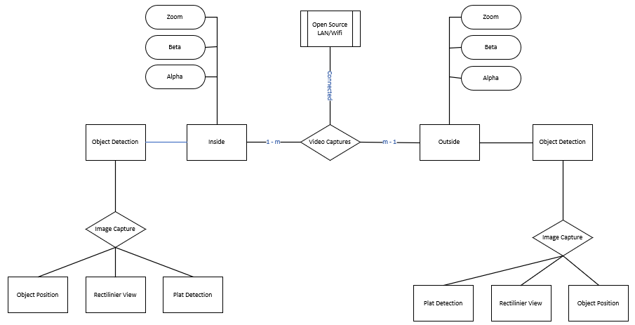
Chapter III. Analysis and Methodology
ERD user interface design

Slide 18
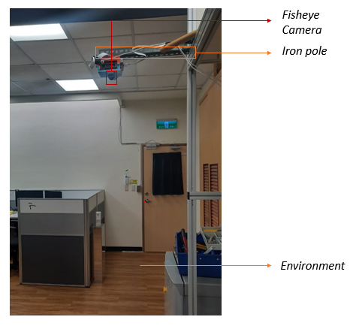
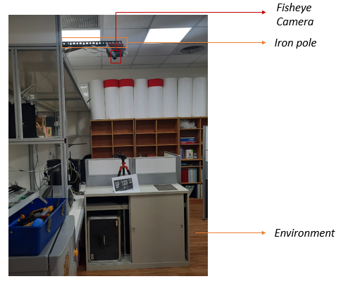
Chapter VI. Experiment Result
Setup entaniya camera position at inside laboratory environment area
Figure 18. From the right of the camera
Figure 19. From the left of the camera
Where:
- Using entaniya camera (fisheye)
- Height = 1.7 meters

Slide 19
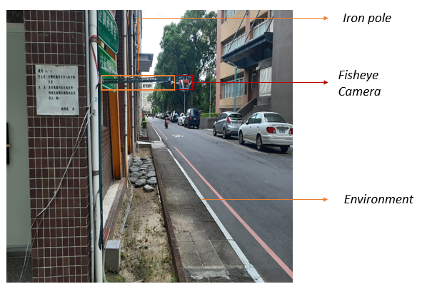
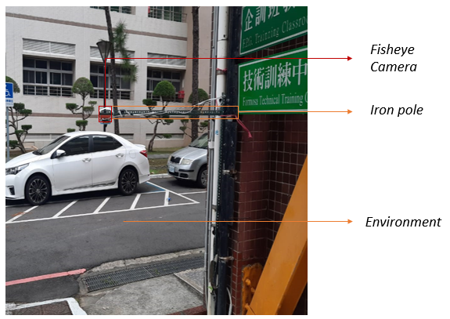
Chapter VI. Experiment Result
Setup entaniya camera position at outside laboratory environment area
Figure 20. From the right of the camera
Figure 21. From the left of the camera
Where:
- Using entaniya camera (fisheye)
- Height = 1.7 meters

Slide 20
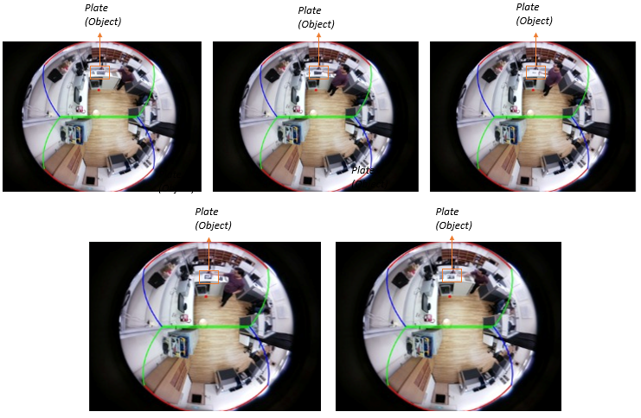
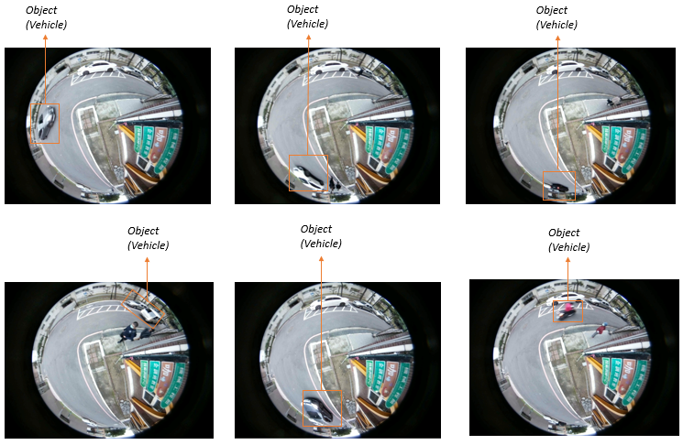
Chapter VI. Experiment Result
Collect the datasets (experiment)
Figure 22. The inside laboratory using
entaniya camera (fisheye)
Figure 23. The outside laboratory using
entaniya camera (fisheye)

Slide 21
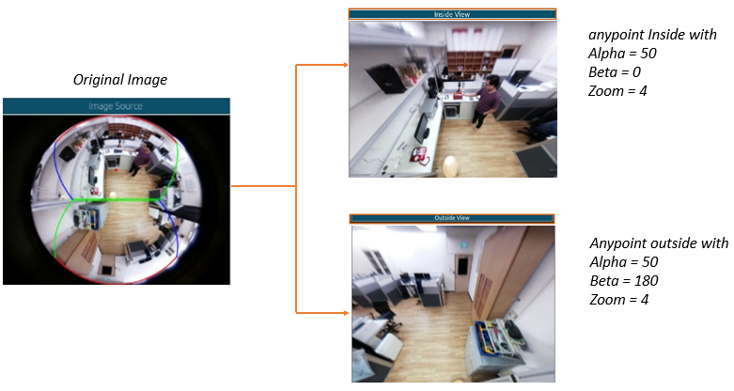
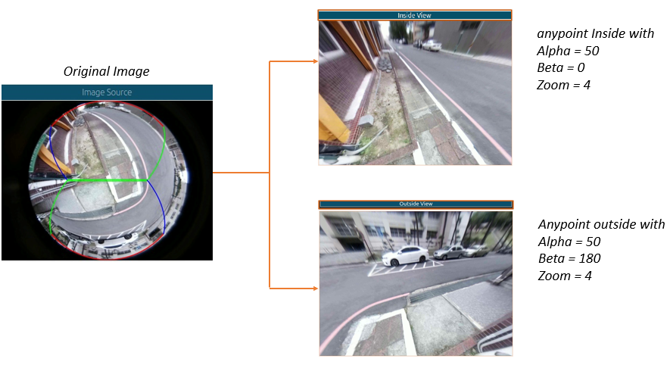
Chapter VI. Experiment Result
Implementation our method to create a rectilinear view
Figure 24. A rectilinear the Inside
laboratory environment
Figure 25. A rectilinear the Outside
laboratory environment

Slide 22
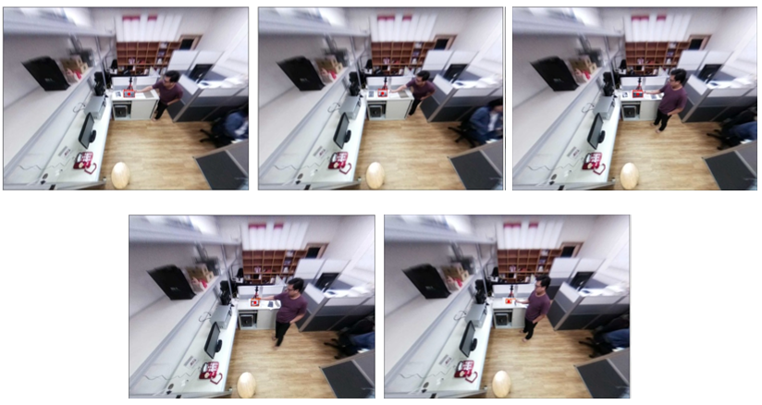
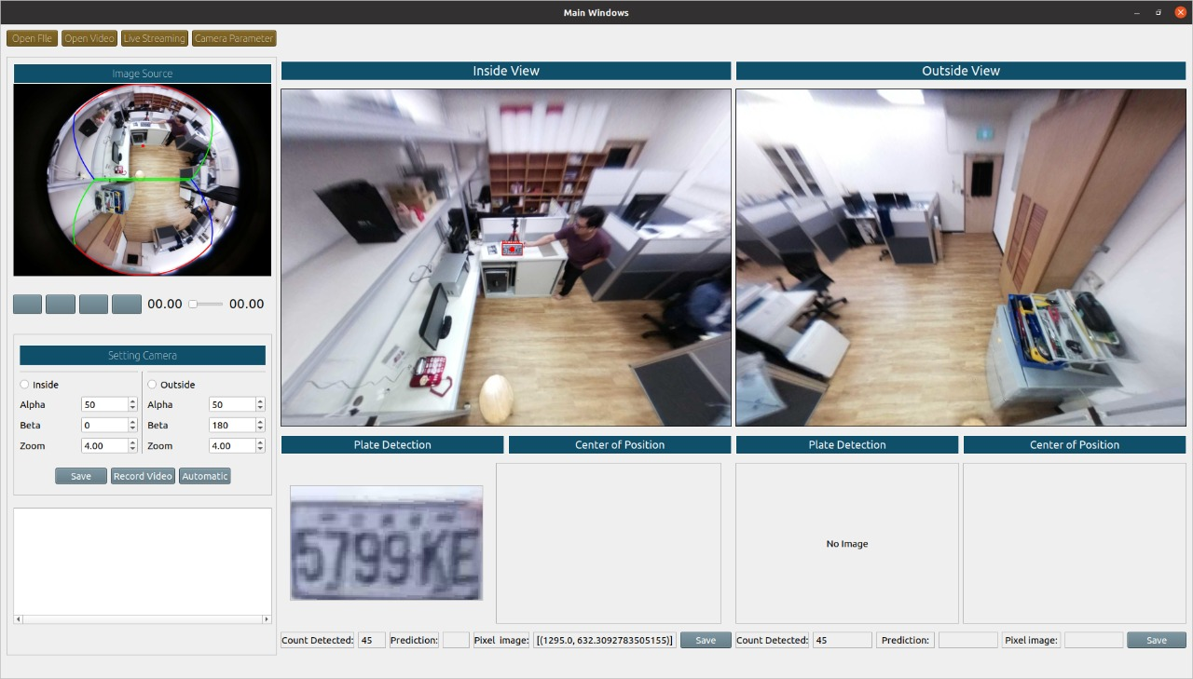
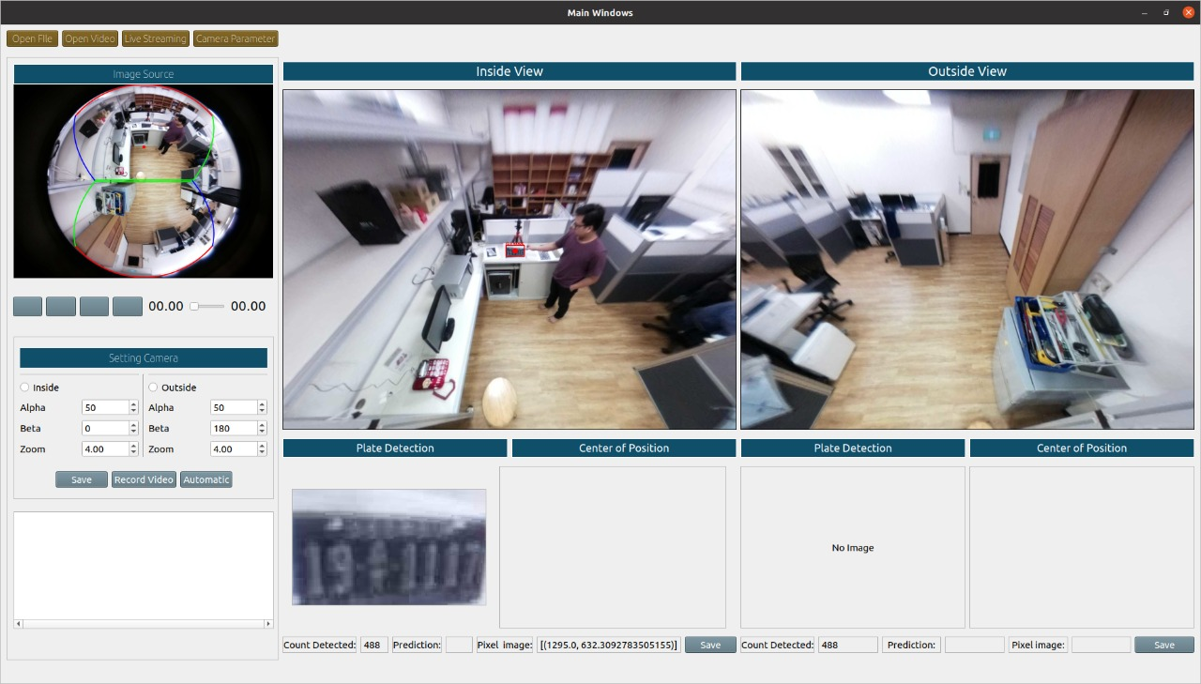
Chapter VI. Experiment Result
Process monitoring system works to detect automatically
Plate detection
Plate detection
Figure 26. Result plate detection the inside laboratory

Slide 23
Chapter VI. Experiment Result
The result prediction accuracy plate detection (Inside Laboratory)
Table 2. Result of the detection to plate detection (inside view)
No | Plate Number | Pixel Image | Width (W) | Height (H) | Prediction (correct)
1. | 5799KE | 1295 | 1368 | 657 | 87.68%
2. | 191117 | 800 | 1139 | 629 | 84.27%
3. | B6703WJF | 340 | 654 | 287 | 80.41%
4. | AAA6385 | 720 | 773 | 340 | 76.56%
5. | BP1309GD | 1265 | 1234 | 650 | 83.38%
Table 3 Result of prediction to plate detection (outside view)
No | Plate Number | Pixel Image | Width (W) | Height (H) | Prediction (correct)
1. | 5799KE | 1295 | 1368 | 657 | 87.35%
2. | 191117 | 800 | 1139 | 629 | 81.03%
3. | B6703WJF | 340 | 654 | 287 | 79.24%
4. | AAA6385 | 720 | 773 | 340 | 78.34%
5. | BP1309GD | 1265 | 1234 | 650 | 80.15%
Where:
- Total of plate entry and exit vehicles used: 5
- Total plate detection: 5

Slide 24
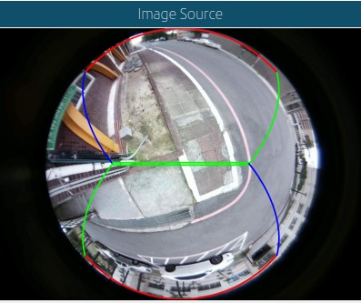
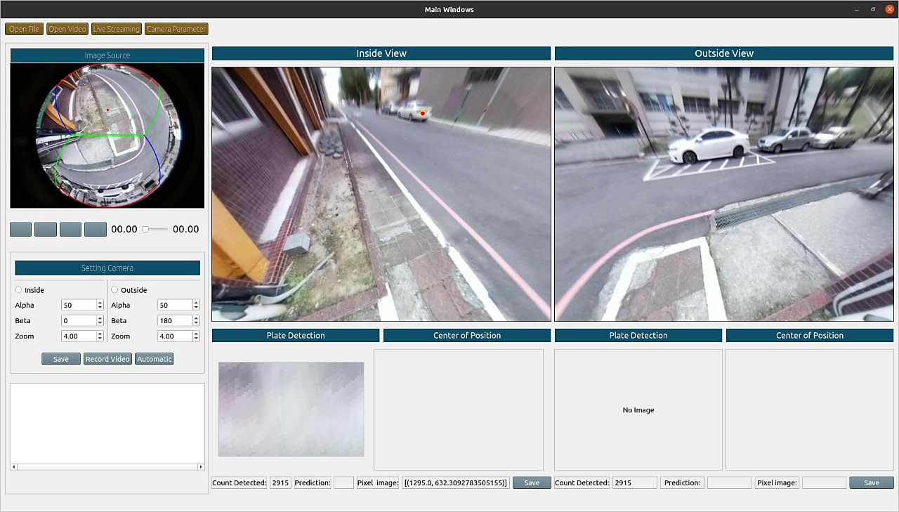
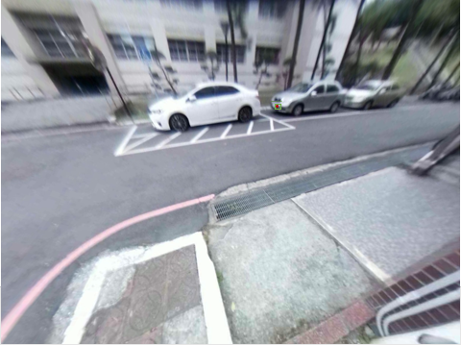
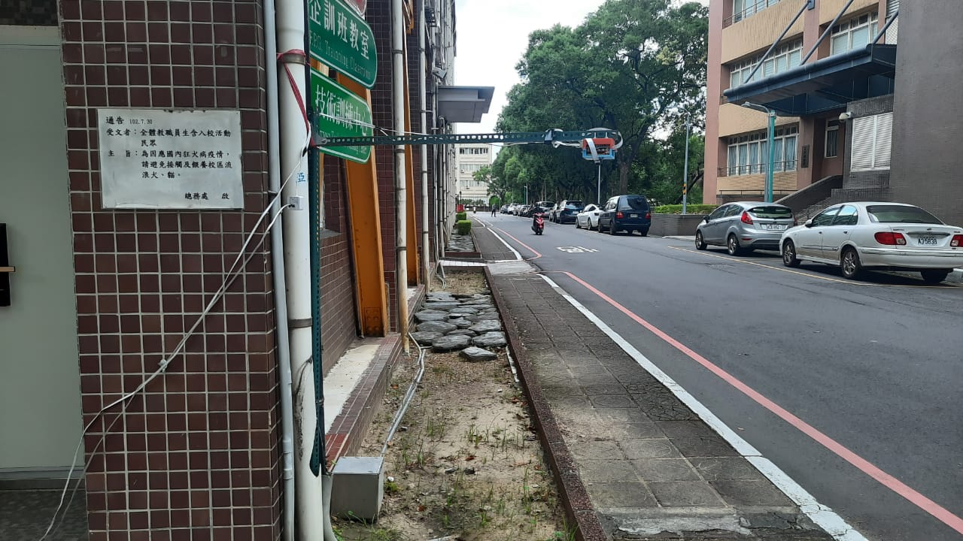
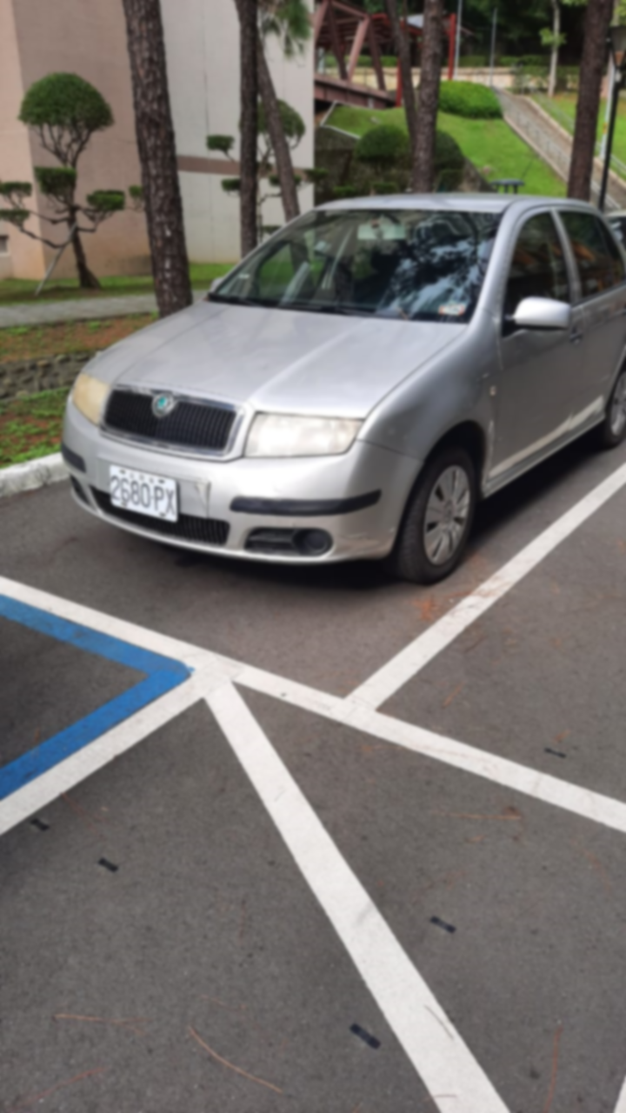
Chapter VI. Experiment Result
Process monitoring system works to detect automatically
Inside view
Outside view
Original image
Plate detection
Plate detection
A. Result plate detection inside view
B. Result plate detection outside view

Slide 25
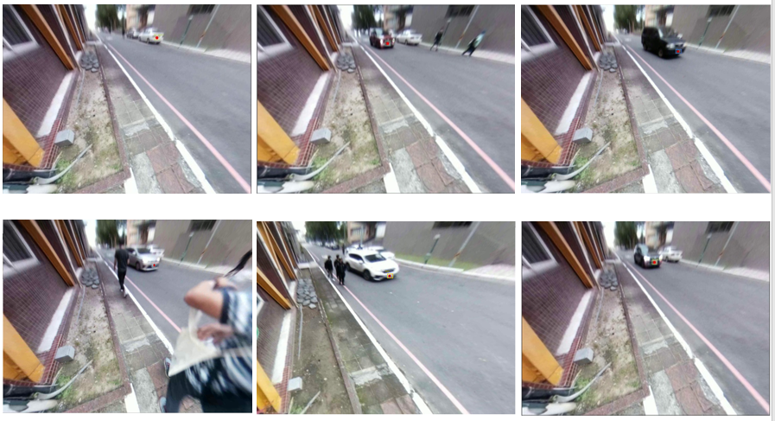
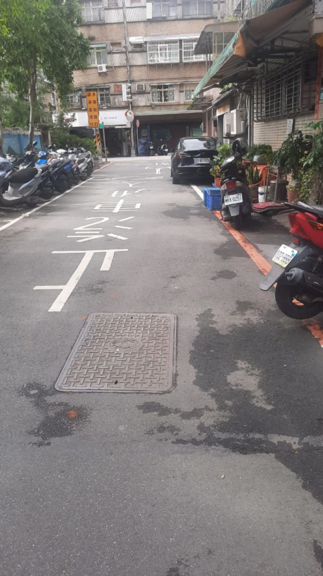
Chapter VI. Experiment Result
Process monitoring system works to detect automatically
Plate detection
Plate detection
C. Other’s result plate detection
Figure 23. (A), (B), (C). The result plate detection the outside laboratory

Slide 26
Chapter VI. Experiment Result
The result prediction accuracy plate detection (outside Laboratory)
Table 2. Result of the detection to plate detection (front view)
No | Plate Number | Pixel Image | Width (W) | Height (H) | Prediction
1. | A35838 | 1295 | 417 | 657 | 87.69 %
2. | EAD1926 | 1295 | 550 | 564 | 84.50 %
3. | 8F5701 | 760 | 460 | 635 | 83.31 %
4. | 1532J6 | 620 | 476 | 649 | 80.03 %
5. | ATT87II | 1265 | 439 | 480 | 85.47 %
6. | 1451KD | 637 | 494 | 615 | 87.15 %
Table 3 Result of prediction to plate detection (back view)
No | Plate Number | Pixel Image | Width (W) | Height (H) | Prediction
1. | 2680PX | 1295 | 317 | 657 | 86.24 %
2. | BLA6058 | 1295 | 455 | 564 | 81.47 %
3. | 7987RJ | 1295 | 476 | 535 | 83.11 %
Where:
- 31 minutes
- Total vehicle entry plate detection: 6
- Total vehicle exit plate detection: 3

Slide 27
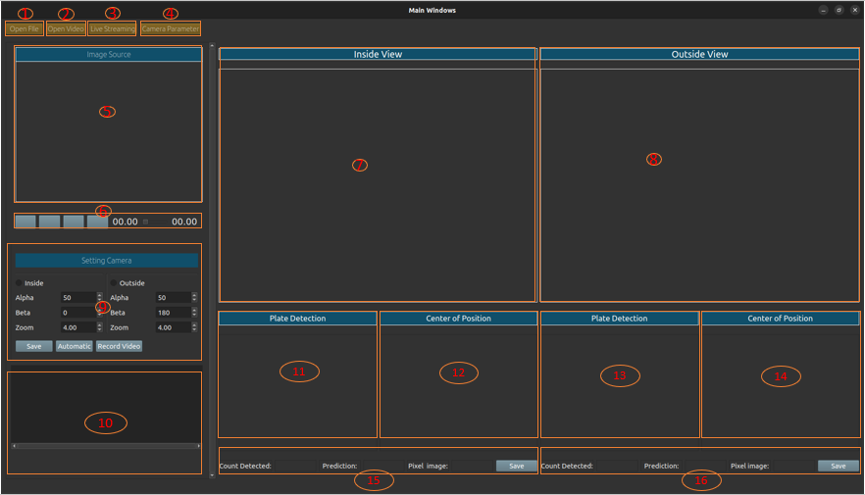
Chapter VI. Experiment Result
Design User Interface Application Monitoring System
Open File
Open Video
Live Streaming
Camera Parameter
9. Setting Camera
10. Scroll area
11. Plate Detection Inside
12. Plate Detection Outside
5. Image source
6. Button Control Video
7. Anypoint Inside view
8. Anypoint Outside view
13. Center of position inside
14. Center of position Outside
15. Result Inside detection
16. Result Outside Detection
Figure 27. User interface system monitoring

Slide 28
Chapter V. Conclusion and Future Work
Conclusion
Based on the experiments conducted, this research has provided an alternative solution for the installation of multiple cameras, and vehicle plate detection has been carried out by:
Experiments in a laboratory environment with the parameters of detecting fake vehicle plates from the front view (inside), a predictive value of 81.46%, and detection of fake vehicle plates from the rearview (outside) is 80.35%.
In experiments conducted outside the environment, the front view (inside) and rear view (outside) detected vehicle plates properly. Only a few vehicle plates were found that needed to be clearer when detected (blur); this is because the resulting image quality could be better outside the environment.

Slide 29
Chapter V. Conclusion and Future Work
Future Work
As future work with the implementation of the proposed algorithm, we can add several complete features in addition to the advantages described in this study, such as:
Automatic ticketing integrated with direct notification to the driver via the email address or other identity of the vehicle owner.
Recognition of entry plates, exits on toll roads with the working system of character recognition on the vehicle plate.
As well as the security of parked vehicles equipped with artificial intelligence technology that reads every movement of objects detected on the camera.
So that the standardization in the implementation of this research can be used in other locations to expand the development of findings that minimize low costs.

Slide 30
Discussion
The experiment was conducted using a laptop with an operating system of Windows 10 and a computer running on Ubuntu 20.04 LTS.
Evaluation of the fisheye camera with the proposed approach of our method was tested in an indoor and outdoor environment.
Create the fisheye camera the main source to create different rectilinear views according to the needs of the target.
Experiments in the laboratory camera are installed at the height of 1.7 meters with good light conditions (not too bright). The height of the pole position where the camera is installed when taking datasets outside the environment is 1.7 meters.

Slide 31
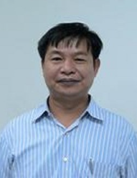
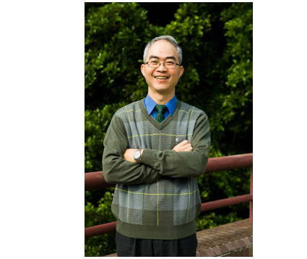
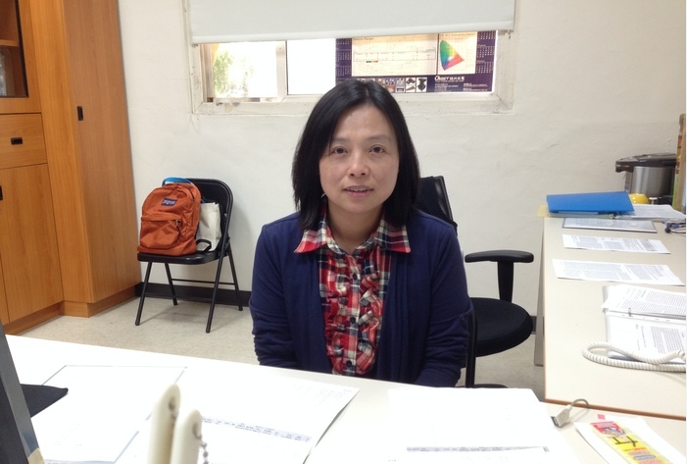

Acknowledgments
Appreciation and sincere thanks to my supervisor, Professor Dr. Chuang-Jan Chang, Ming-Chi Omnidirectional Imaging Laboratory (MOIL) has allowed me to conduct research and has always provided invaluable guidance from the first time the author came to Taiwan until throughout this research.
Professor Dr. Jin-Wei Liang, has provided the opportunity and financial support for the author to complete his education.
Professor Dr. Ya-Fen Wu, as the Head of the Electronics Engineering program, has provided the opportunity to direct and motivate the author in completing this thesis.
Professor Dr. Shu-Lin Hwang, is a supervisor who is full of ability and willingness to spend quite a lot of time guiding me in completing this thesis.

Slide 32
References
[1] | M. A. S. S. J. H. A. K. I. K. M. G. A. A.-F. Ammar Gharaibeh, "Smart Cities: A Survey on Data Management, Security, and Enabling Technologies," IEEE COMMUNICATIONS SURVEYS & TUTORIALS,, vol. 19, pp. 2456-2501, 2017.
[2] | Myounggyu, "Intelligent Traffic Monitoring Systems for Vehicle Classification: A Survey," IEEE Access, vol. 8, pp. 73340-73357, Februari 2020.
[3] | T. R. P. F. Remigiusz Baran, "A smart camera for the surveillance of vehicles in intelligent transportation systems," Multimed Tools Appl, p. 10471–10493, 2016.
[4] | I. E. A. I. D. P. V. L. E. K. Christos-Nikolaos E. Anagnostopoulos, "License Plate Recognition From Still Images and Video Sequences: A Survey," IEEE TRANSACTIONS ON INTELLIGENT TRANSPORTATION SYSTEMS, vol. 9, pp. 377-391, Sept 2008.
[5] | T. W. a. B. Rinner, "Security and Privacy Protection in Visual Sensor Networks: A Survey," ACM Computing Surveys, vol. 47, pp. 2:1-2:42, April, 2014.
[6] | L.-C. C. D.-Y. C. Jun-Wei Hsieh, "Symmetrical SURF and Its Applications to Vehicle Detection and Vehicle Make and Model Recognition," IEEE TRANSACTIONS ON INTELLIGENT TRANSPORTATION SYSTEMS, vol. 15, pp. 6-20, Feb 2014.
[7] | C.-J. C. GWO-Jen Jan, "Method for Exploring ViewPoint and Focal Length of Camera". Taiwan Patent US 6,985,183 B2, 10 January 2006.
[8] | Y. L. L.-M. D. a. H. M. Hanxiang Wang, "Robust Korean License Plate Recognition Based on Deep Neural Network," MDPI - Publisher of Open Access Journals, pp. 1-18, 2021.
[9] | C.-Y. W. H.-Y. M. L. Alexey Bochkovskiy, "YOLOv4: Optimal Speed and Accuracy of Object Detection," Semantic Scholar (arXiv), pp. 1-17, 2020.
[10] | S.-K. K. S.-H. L. T.-M. L. a. J. L. Jung-Hwan Kim, "License Plate Detection and Recognition Algorithm for Vehicle Black Box," Proceedings of the 2017 International Automatic Control Conference (CACS), pp. 1-6, Nov 2017.
[11] | J.-Y. S. S.-h. P. Jeong-ah Kim, "Comparison of Faster-RCNN, YOLO, and SSD for Real-Time Vehicle Type Recognition," In Proceedings of the 2020 IEEE International Conference on Consumer Electronics-Asia (ICCE-Asia) , pp. 1-3, Nov 2020.

Slide 33
References
[12] | L.-S. C. Y.-C. C. a. S.-W. C. Shyang-Lih Chang, "Automatic License Plate Recognition," IEEE Transactions on Intelligent Transporttation System, pp. 42-53, Upload by Sei-Wang Chen on September 2014.
[13] | H. Z. a. M. K. Michael Hodlmoser, "An Evaluation of Camera Calibration Methods Using Digital Low Cost Cameras," in Computer Vision Winter Workshop 2010, Libor Spa 'cek, Vojt' ech Franc, Austria, 2010.
[14] | E. Ozcakir, "Camera Calibration With OpenCV," Access on April 27, 2022, Available on: https://medium.com/@elifozcakiir/camera-calibration-with-opencv-9fb104fdf879, Sep 18, 2020.
[15] | A. M. R. S. Davide Scaramuzza, "A Toolbox for Easify Calibrating Omnidirectional," in Iros, Beijing, China, 2006.
[16] | C. Mei, "Central Catadioptric System," Inria, [Online]. Available: http://www-sop.inria.fr/icare/personnel/Christopher.Mei/ChristopherMeiPhDStudentToolbox.html. [Accessed 22 May 2021].
[17] | OpenCV, "Camera Calibration," [Online]. Available: https://docs.opencv.org/master/dc/dbb/tutorial_py_calibration.html. [Accessed 22 May 2021].
[18] | C.-J. C. GWO-Jen Jan, "Method for Exploring ViewPoint and Ffocal Length of Camera". Taiwan Patent US 6,985,183 B2, 10 January 2006.
[19] | B. L. a. M. P. Lionel Heng, "CamOdoCal: Automatic intrinsic and extrinsic calibration of a rig with multiple generic cameras and odometry," 2013 IEEE/RSJ International Conference on Intelligent Robots and Systems, pp. pp. 1793-1800, 2013.
[20] | V. Tyagi, Understanding Digital Image Processing, Guna (MPI), India: Department of Computer Science and Engineering Jaypee University of Engineering and Technology Raghogarh, 2018.
[21] | G. L. Loay Alzubaidi, "Real time License Saudi Plate Recognition Using Raspberry Pi," International Journal of Advanced Trends in Computer Science and Engineering, vol. 8, pp. 42-47, 2019.
[22] | G. S. Kothman, "U.S. Patent and Trademark Office," no. U.S. Patent No. D163,328, 1951.

Slide 34
References
[23] | S. A. L. P. R. System, "Muhammad Sarfraz, Mohammed Jameel Ahmed, and Syed A. Ghazi," Proceedings of the 2003 International Conference on Geometric Modeling and Graphics (GMAG’03) IEEE, pp. 1-6, 2003.
[24] | H. S. W. Z. L. L. Lin Luo, "An Efficient Method of License Plate Location," International Conference on Information Science and Engineering (ICISE), pp. 770-773, 2009.
[25] | B. A. H. R. S. B. Reza Azad, "Real-Time and Efficient Method for Accuracy Enhancement of Edge," International Conference on computer, Information Technology and Digital Media (CITADIM Proceeding-Scientific), pp. 146-155, 2013.
[26] | "Towards End-to-End License Plate Detection and Recognition: A Large Dataset and Baseline," Springer, Computer Vision Foundation (ECCV), pp. 1-17, 2018.
[27] | P. W. n. C. S. Hui Li, "Towards End-to-End Car License Plates Detection and Recognition with Deep Neural Networks," IEEE Transactions on Intelligent Transportation System , pp. 1-9, Dec 2017.
[28] | D. A. D. E. C. S. S. R. C.-Y. F. A. C. B. Wei Liu, "SSD: Single Shot MultiBox Detector," arXiv:1512.02325v5 [csCV], pp. 1-17, 2016.
[29] | K. H. R. G. a. J. S. Shaoqing Ren, "Faster R-CNN: Towards Real-Time Object Detection with Region Proposal Networks," IEEE TRANSACTIONS ON PATTERN ANALYSIS AND MACHINE INTELLIGENCE, vol. 60, pp. 1137-1149, June 2017.
[30] | K. S. A. V. A. Z. Max Jaderberg, "Synthetic Data and Artificial Neural Networks for Natural Scene Text Recognition," arXiv:1406.2227v4 [cs.CV] 9 Dec 2014, pp. 1-10, Dec 2014.
[31] | L. Z. X. L. X. W. D. T. Fangfang Wang, "Geometry-Aware Scene Text Detection with Instance Transformation Network," IEEE/CVF Conference on Computer Vision and Pattern Recognition, pp. 1381-1389, 2018.
[32] | "Raspberry Pi," Access on April 24, 2022, Available:https://en.wikipedia.org/wiki/Raspberry_Pi, June 24, 2019.
[33] | G. Halfacree, "Raspberry Pi Beginner's Guide," Publish in 2020 by Raspberry Pi Trading Ltd, Maurice Wilkes Building, St. John's Innovation Park, Cowley Road, Cambridge, CB4 0DS, no. ISBN: 978-1-912047-73-4, pp. 1-248, 2020.

Slide 35
References
[34] | L. Hattersley, "How to set up Raspberry Pi 4," Access on: April 27 2022, Available on : https://magpi.raspberrypi.com/articles/set-up-raspberry-pi-4, 2019.
[35] | "Raspberry Pi Documentation," Access on April 24, 2021 Availabel: https://www.raspberrypi.com/documentation/accessories/camera.html.
[36] | G. k. surabaya, "Fisheye Lens Alias Artistic Fisheye Lens," Access on April 26, 2022 Available: https://www.gudangkamera.net/blogs/21-lensa_fisheye_alias_lensa_mata_ikan_yang_artistik.html, 2017.
[37] | OpenCV, "About OpenCV Library," [Online]. Available: https://opencv.org/about/. [Accessed 15 June 2021].
[38] | Haryanto, "Moildev, Python Package Index (PyPI)," Perseverance Technology, Ming Chi University of Technology, Taiwan, [Online]. Available: https://pypi.org/project/Moildev/. [Accessed 16 June 2021].
[39] | A. F. Jeseph Redmon, "YOLOv3: An Incremental Improvement," arXiv.1804.02767, pp. 1-6, 2018.
[40] | J. G. Z. H. a. J. W. Jing Li, "Application Rresearch of Improved YOLO V3 Algorithm in PCB Electronic Component Detection," Applied Sciences MDPI journal, pp. 1-21, 2019.
[41] | Y. J. Z. W. Z. C. T. H. Jiahui Yu, "UnitBox: An Advanced Object Detection Networkk," arXiv:160801471v1, pp. 1-5, 2016.
[42] | N. T. J. Y. G. A. S. I. R. S. S. Hamid Rezatofighi, "Generalized Intersection Over Union: Matric and A Loss for Bounding Box Regression," arXiv:1902.09630v2, pp. 1-9, 2019.
[43] | J. Redmon∗, "You Only Look Once Unified, Real-Time Object Detection," IEEE Conference on Computer Vision and Pattern Recognition , pp. 779-788, June 2016.
[44] | A. F. Joseph Redmon, "YOLO9000: Better, Faster, Stronger," IEEE Conference on Computer Vision and Pattern Recognition, pp. 6517-6525, July 2017.
[45] | D. A. D. E. C. S. Wei Liu, "SSD: Single Shot MultiBox Detector," In Proceedings of the European Conference on Computer Vision (Springer International Publishing: Cham, Switzerland), pp. 11-14, Oct 2016.
[46] | H. P. D. M. a. C. P. Jithmi Shashirangana, "Automated License Plate Recognition: A Survey on Methods and Techniques," IEEE Access , vol. 9, p. 11203–11225, Dec 2020.

